Slide 1

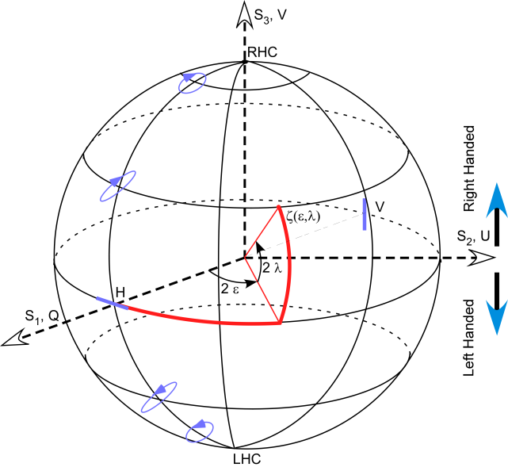
self-calibrating polarimeters and advanced image-like data reconstruction/processing algorithms
J. Zallat, S. Faisan, M. Karnoukian, C. Heinrich, M. Torzynski, A. Lallement

Slide 2
Polarization imaging
Access specific properties of objects and media.
Application dependent.
Distributed measurements of polarization parameters
Physical imaging modality
Observation model
Measured quatities
(radiances)
Physical quantities
Stokes - Mueller
Experimental developments
Polarimeters
Calibration
  Authenticate acquisitions
  Robustness
Theoretical developments
Model inversion
Polarization algebra
Signal/Image processing
Physical interpretation
Relevant display

Slide 3
Polarization imaging consists in an indirect distributed measurement of polarization properties of light. Observables that lead to desired physical quantities are “noisy”.
A multi-component information is attached to each pixel of the image.
Simple observation model that amplify noise when classical pseudo-inverse approach is used.
Classical analysis methods are pixel-wise oriented.
Notes:
Prologue:
1.) Motivations
2.) Historique
3.) Métrologie par vision
Polarimétrie et Image:
Définition de la polarisation
Formalismes de polarisation
Systèmes de mesure – polarimètres imageurs
Problèmes potentiels

Slide 4
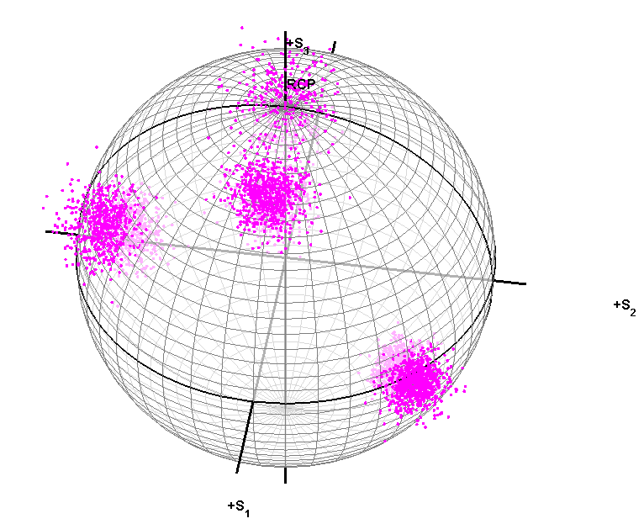
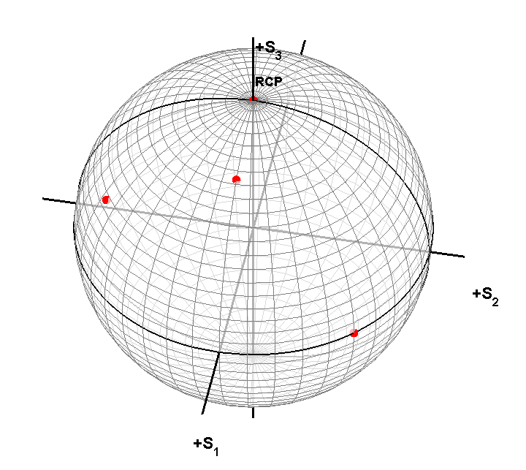
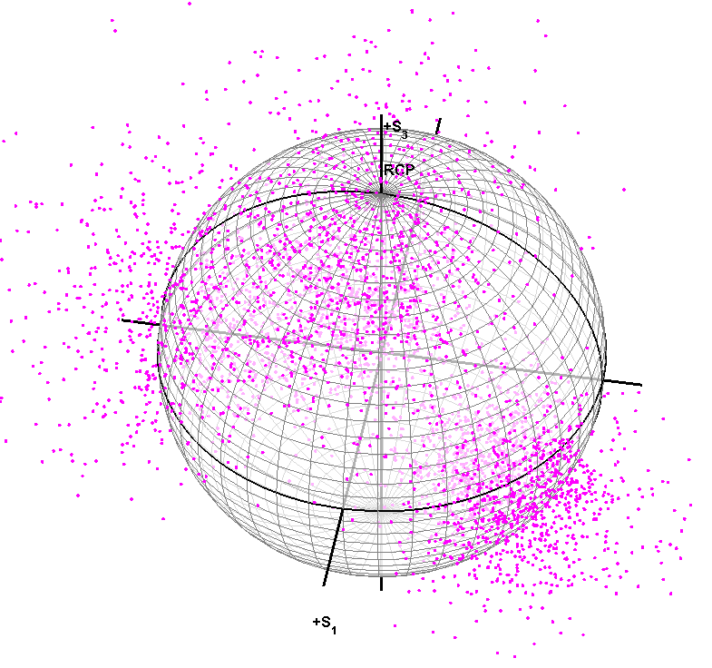
SNR = 20 dB: 54% des pixels sont non admissibles!
SNR = 10 dB: 57% des pixels sont non admissibles!

Slide 5
Application: données synthétiques
True Mueller
Intensities
Better approach
Naïve inversion

Slide 6
Application: données réelles (1)

Slide 7
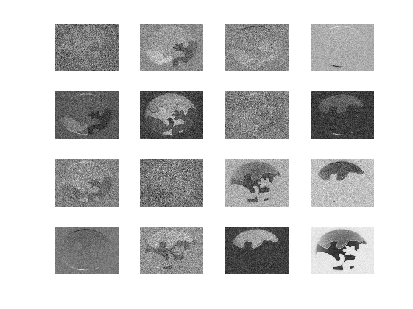
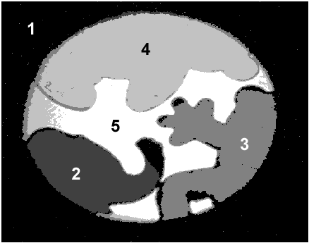
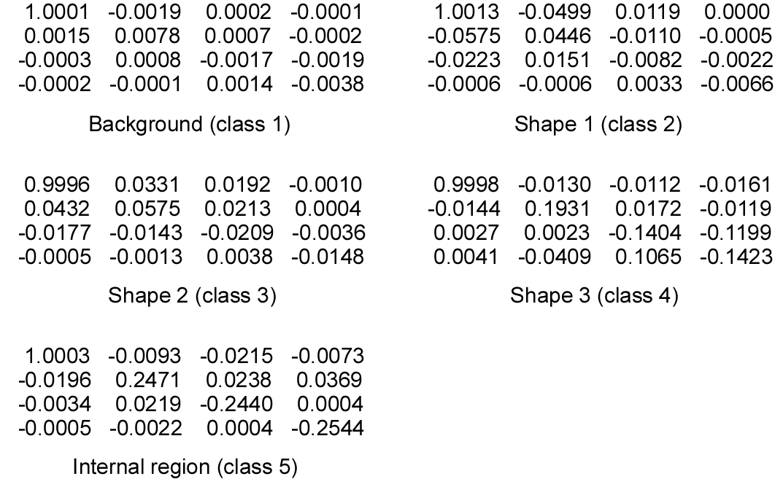
Application: données réelles (2)

Slide 8
DOP image: naïve approach

Slide 9
DOP image: better approach

Slide 10
DOP images

Slide 11
Polarimetric Calibration
Spectral calibration of a polarimeter: RWP

Slide 13
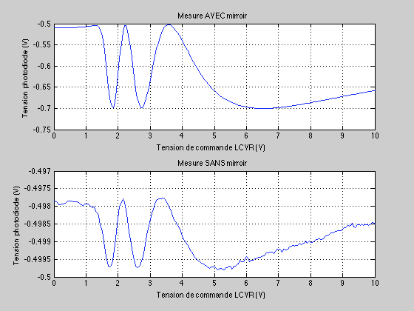
Spectral calibration of a polarimeter: LCVR

Slide 14
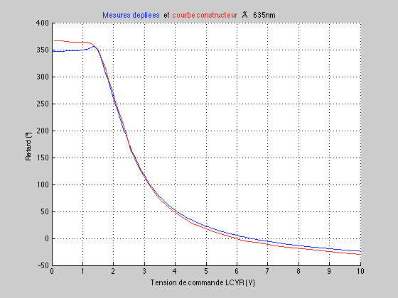

Slide 15
Spectral calibration of a polarimeter: LCVR
Classical LCVR - PSA
P
L1
L2
New LCVR – PSA
Differential PSA
P
L1
HW
L2

Slide 16
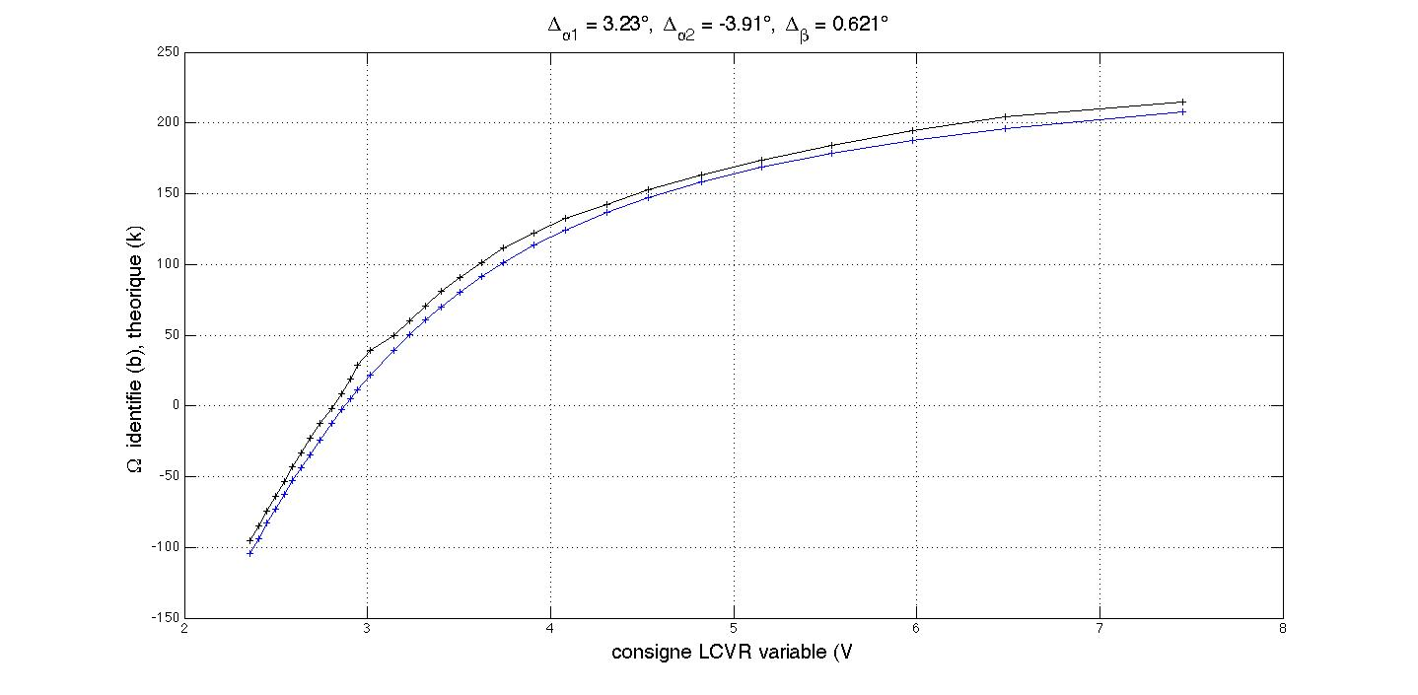
Spectral calibration of a polarimeter: Without Polarizer

Slide 17
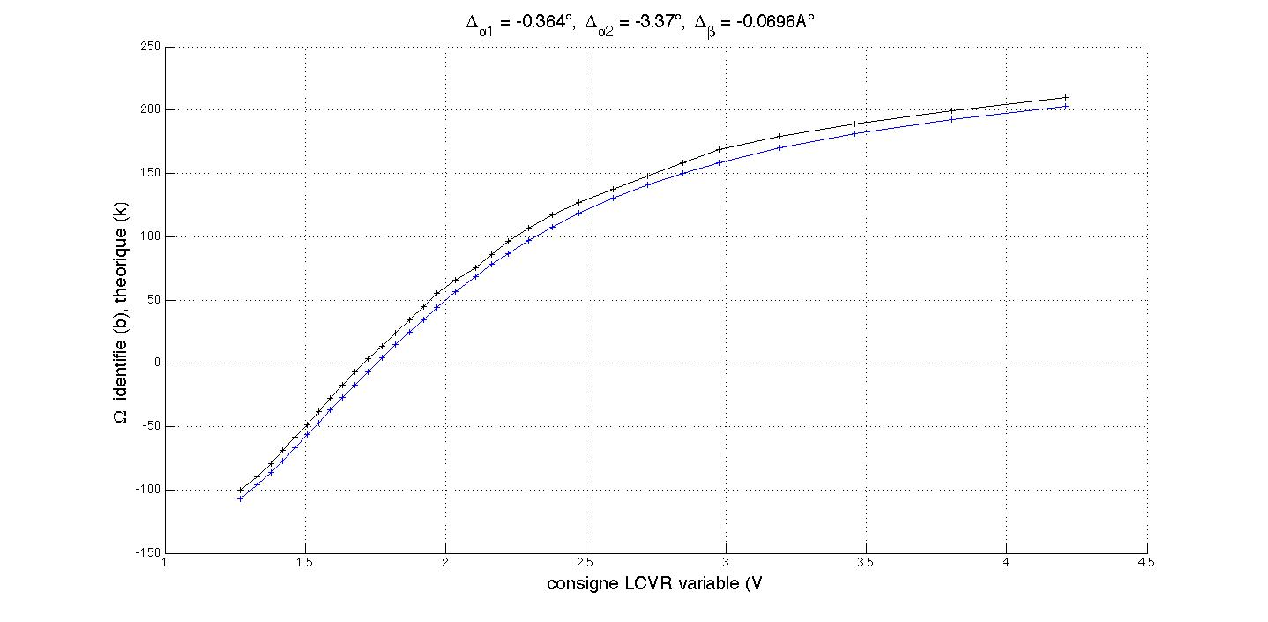
Spectral calibration of a polarimeter: With Polarizer

Slide 18
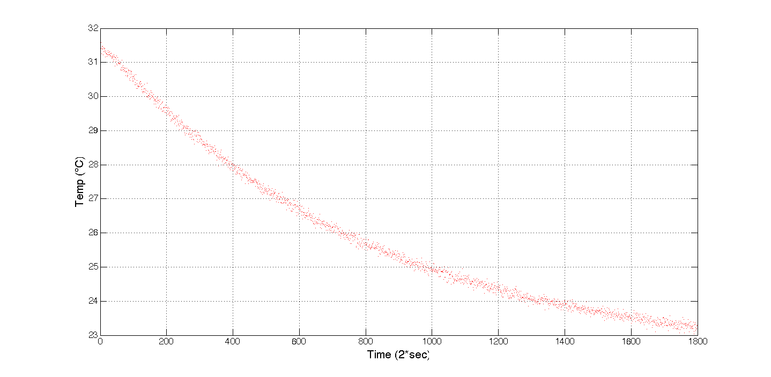
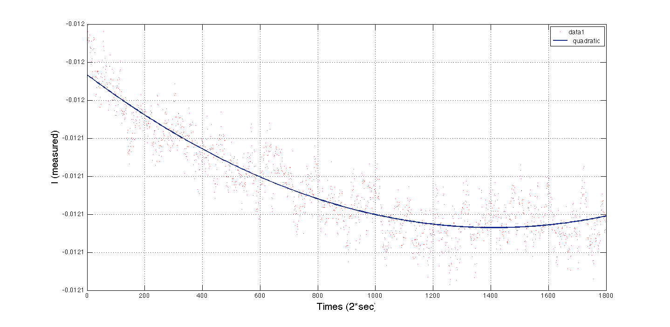
Spectral calibration of a polarimeter: Stability
P
L1
HW
L2
P’

Slide 19
Very well conditioned polarimeter.
The PSA is very stable, no necessity to recalibrate over a long period!
It is used now to construct a full field Mueller imaging polarimeter dedicated to small animals tissues studies.

Slide 20
Data reduction
For each pixel location (s), we have
For each class:
To account for non uniform illumination, a gaussian mixture density is used to model:

Slide 21
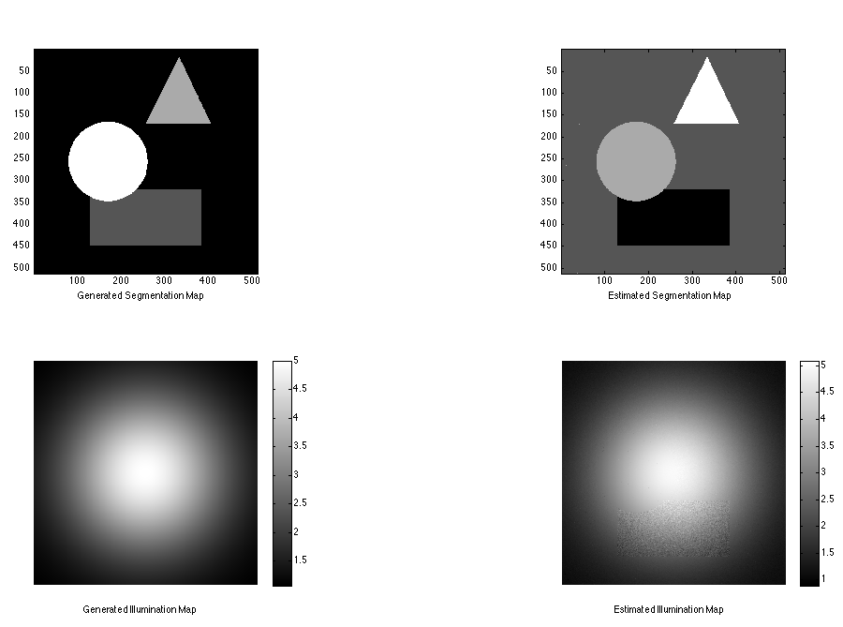
Data reduction: synthetic data

Slide 22
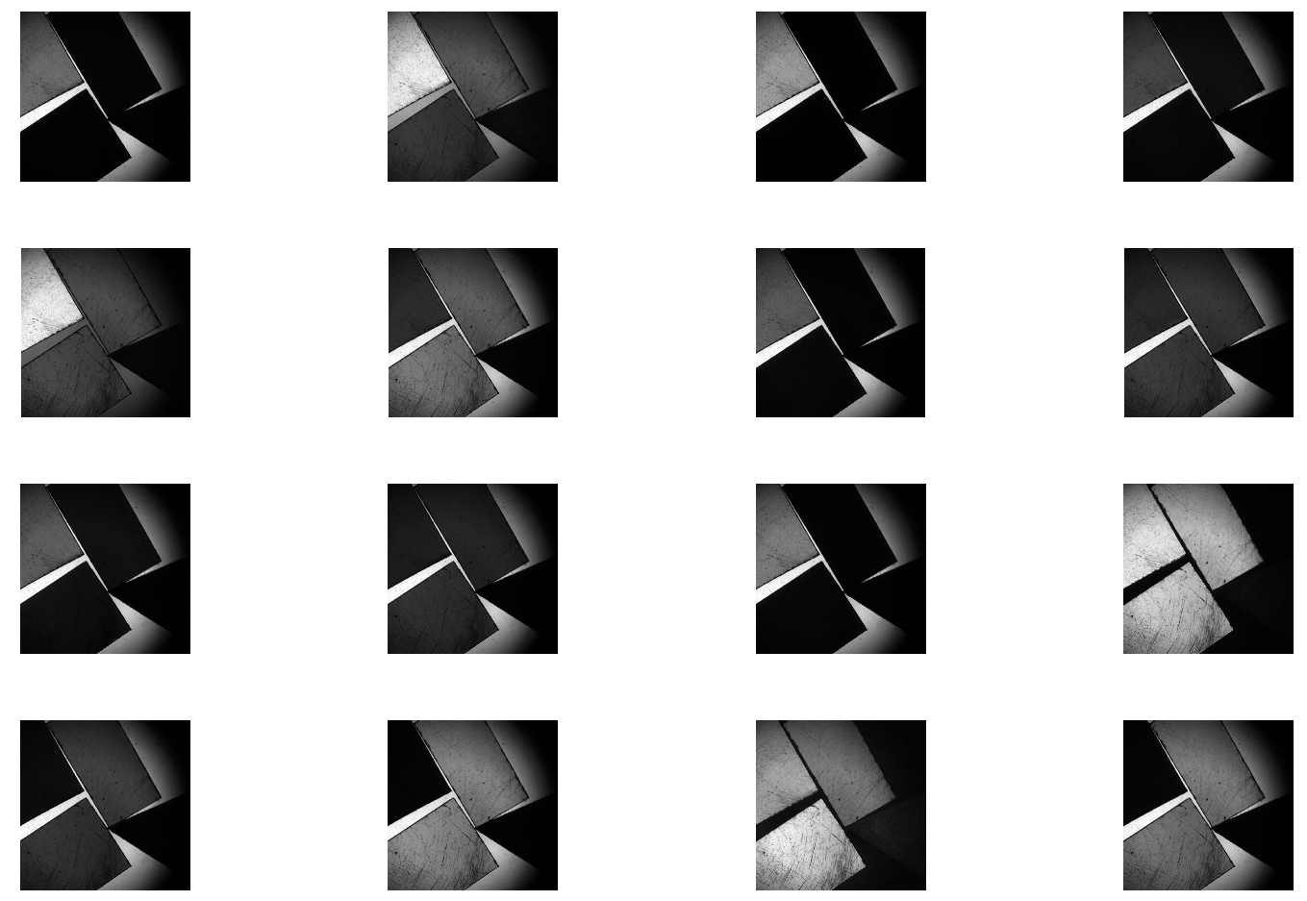
Data reduction: real data (intensities)

Slide 23
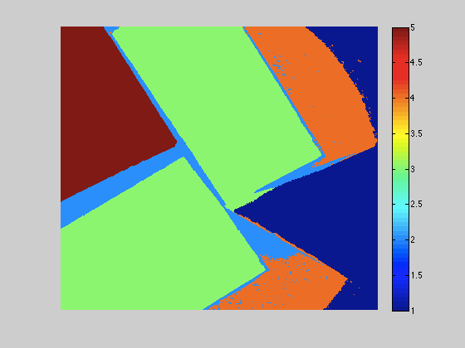
Data reduction: real data

Slide 24
M1 = [ 1.0000 0.0044 -0.0243 0.0488
-0.0166 0.3616 -0.0552 -0.1671
-0.0417 -0.0122 0.2991 -0.3169
-0.0077 0.1675 0.2551 0.2231 ]
M2 = [ 1.0000 0.0249 0.0101 0.0014
0.0135 0.9011 -0.2090 -0.3613
0.0115 -0.1105 0.6968 -0.6963
0.0179 0.4028 0.6741 0.6083 ]
M3 = [ 1.0000 -0.3102 -0.5205 0.7648
-0.4711 0.1691 0.2453 -0.3734
-0.8678 0.2605 0.4672 -0.6785
-0.0083 0.0112 0.0224 0.0052 ]
M4 = [ 1.0000 0.0053 0.0075 0.0052
0.0012 0.8993 -0.2341 -0.3621
0.0042 -0.0898 0.7110 -0.6907
0.0069 0.4224 0.6565 0.6171 ]
M5 = [ 1.0000 0.4296 0.4694 -0.7280
0.5207 0.2426 0.2414 -0.3865
0.8273 0.3613 0.4156 -0.6273
0.0013 0.0042 0.0285 0.0002 ]

Slide 25
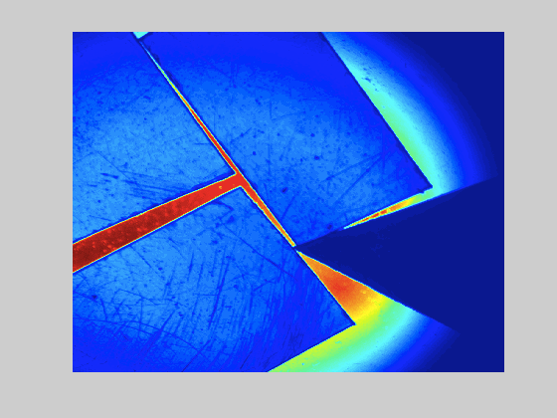

Slide 26
Conclusion
Efficient imaging polarimetry:
Balance between system complexity and ad hoc data reduction algorithms.
To find an information, it must be present in the data: The most informative data are the « raw data ».

