Slide 1
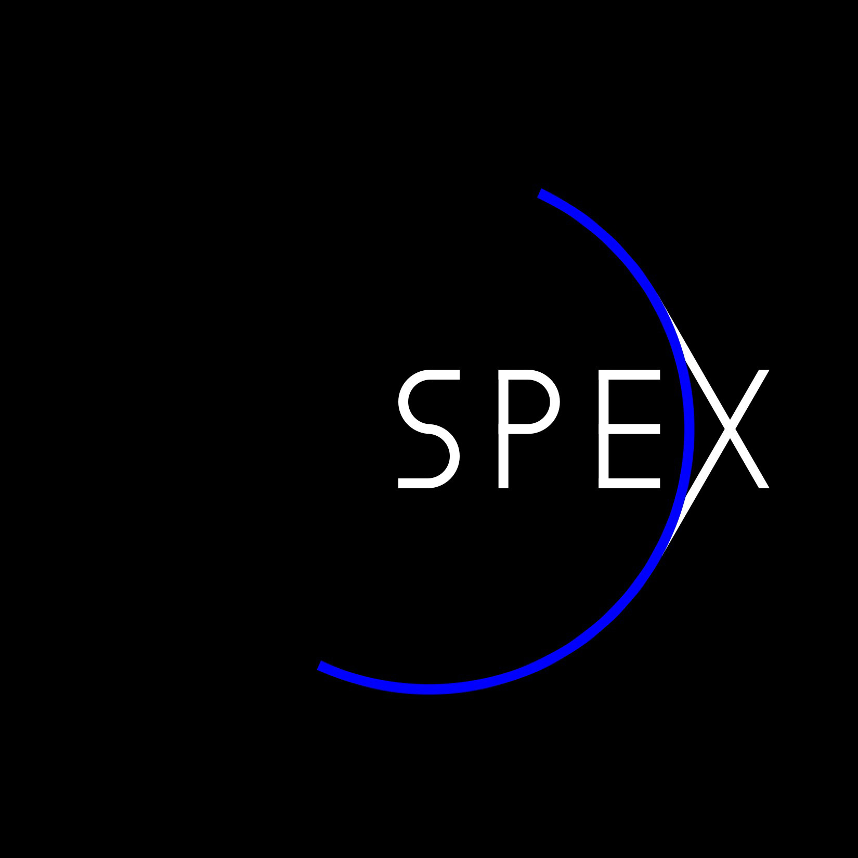
Partially Polarized Calibration Stimulus
Gerard van Hartenª, Frans Snikª, Christoph Kellerª,
Jeroen Rietjens^{b}, Martijn Smit^{b}
ªLeiden University, The Netherlands
^{b}SRON Netherlands Institute for Space Research
Calibration Workshop of the MP1104 COST Action
January 2013
Zurich, Switzerland

Slide 2
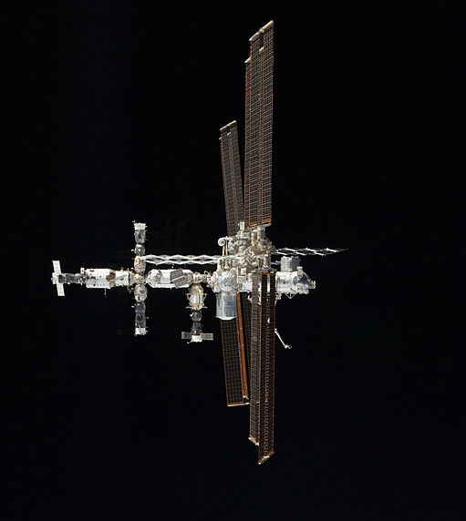
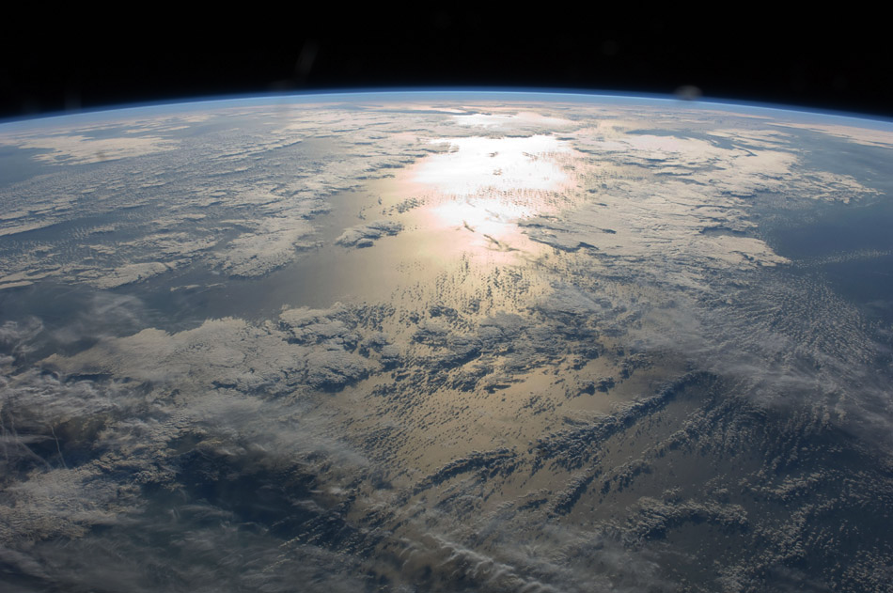
Atmospheric aerosols
Size
Shape
Chemical composition

Slide 3
Measurements
Stokes I, Q, U
Multiple wavelengths
Multiple scattering angles

Slide 4
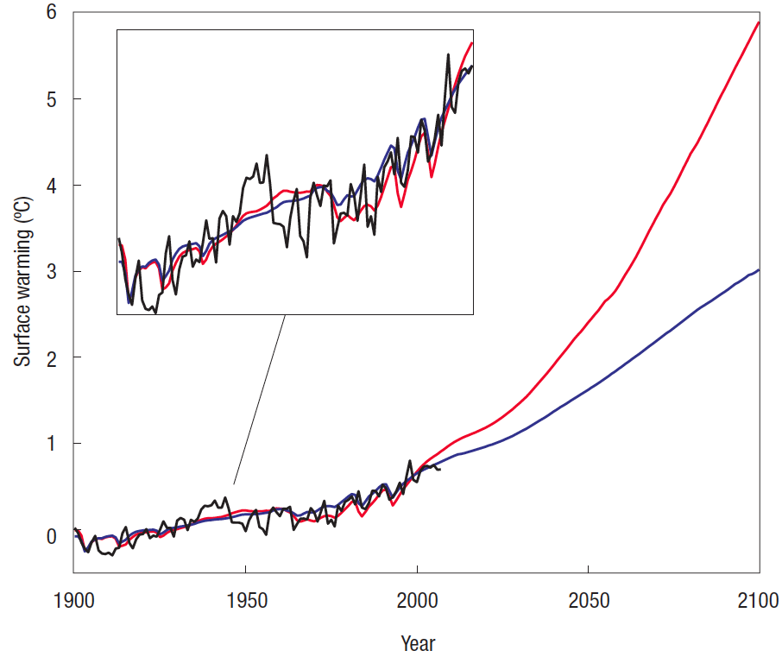
Instrument requirements
Aerosol cooling & climate sensitivity mixed.
Disentangle in 20 years:
400-800 nm
30 viewing angles
σP=0.001+0.005×P
Knutti & Hegerl (2008)
Mishchenko et al. (2004)
Hasekamp & Landgraf (2007)
Notes:
Climate sensitivity: warming effect of CO2
Polarimetric accuracy for refractive index requirement

Slide 5
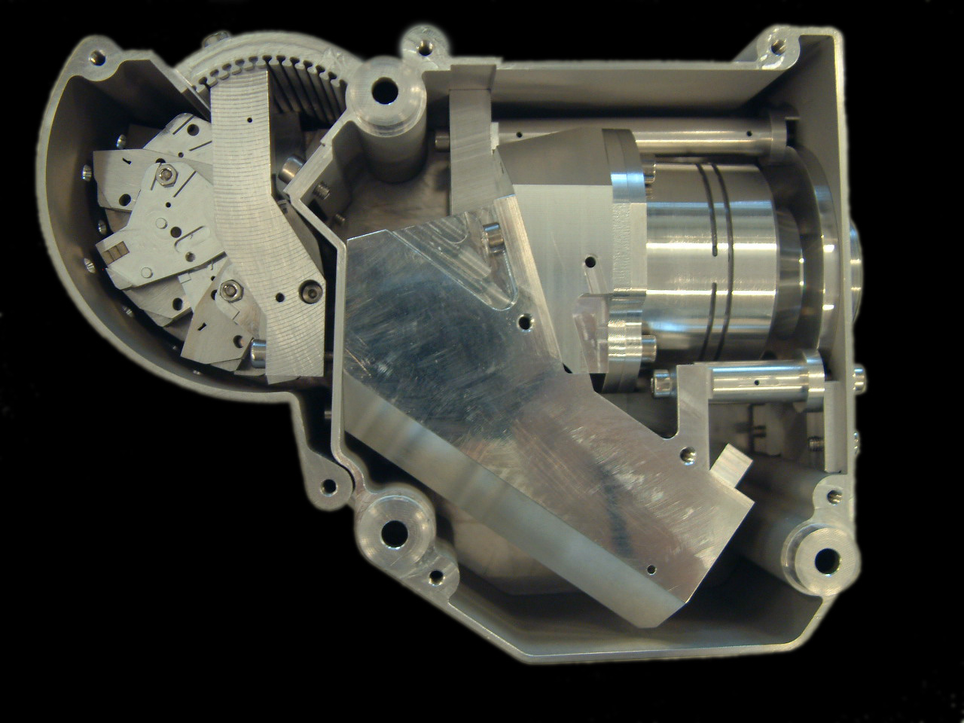
SPEX prototype
60 mm
190 mm
100 mm
spectral range: 400-750 nm
spectral resolution (flux): 1 nm
spectral resolution (polarization): 20 nm
volume: 1.1 dm³
mass: 1.0 kg

Slide 6
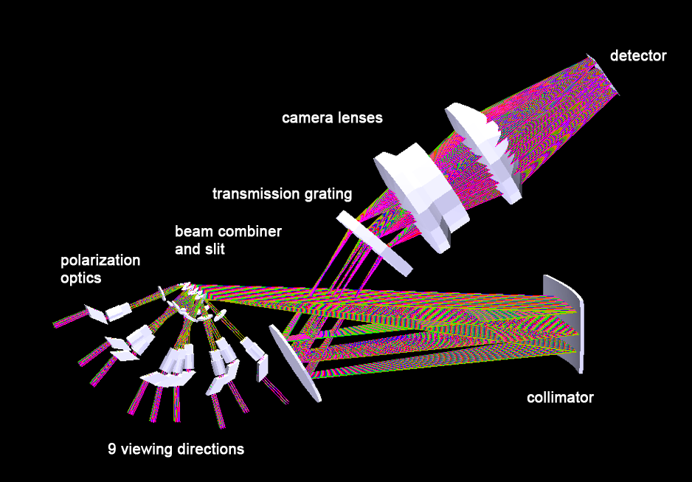
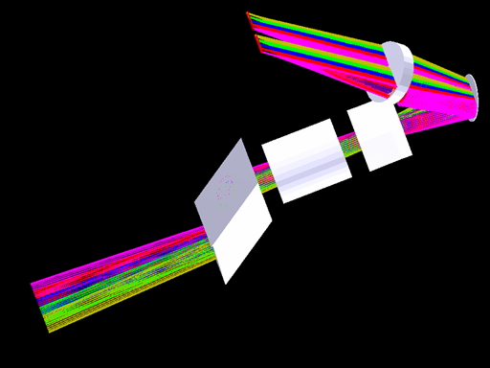
SPEX prototype
60 mm
190 mm
100 mm
spectral range: 400-750 nm
spectral resolution (flux): 1 nm
spectral resolution (polarization): 20 nm
volume: 1.1 dm³
mass: 1.0 kg

Slide 7
SPEX polarimetry
DoLP variation
AoLP variation
Snik et al. (2009)

Slide 8
Polarimeter calibration
Rotating polarizer
P=1
σP=0.0001 (accuracy)
2. Tilted glass plate
0.05<P<0.40
σP=0.01 (stability)
STOTA calibration stimulus
0<P<0.40
σP=0.0005 (stability + accuracy)
Notes:
1.
Expensive polarizer -> high extinction ratio: by design
Polarimeters often measure very low P -> how does it behave? What is the zero-point, is the response linear?
Accuracy: we just don’t know / cannot promise anything below sP=0.0001
2.
Glass plate partial polarizer -> lamp polarization leaks through; polarization wavelength dependent
sensitive to lamp polarization fluctuations -> stability
3.
State-of-the-art stimulus
P down to 0
more

Slide 9
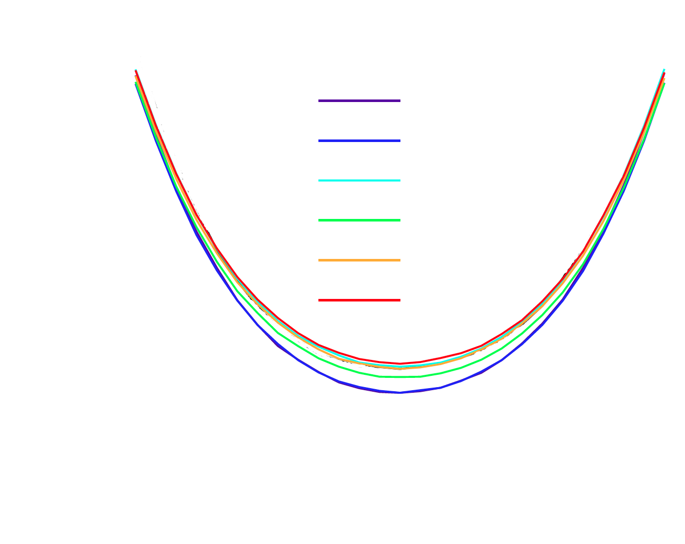
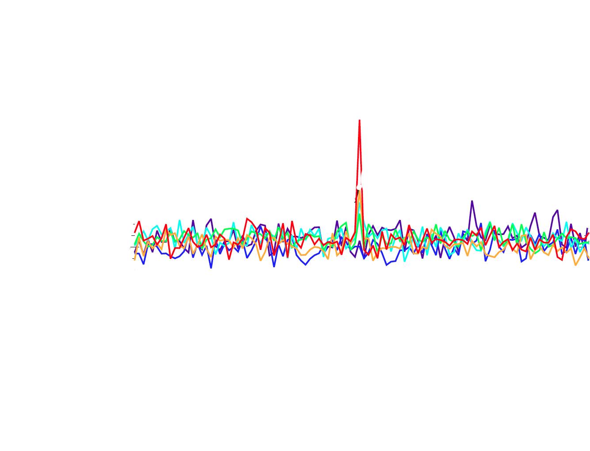
Current SPEX calibration
Just a tilted glass plate
2×10⁻⁴ DoLP sensitivity
Notes:
MM model – free parameters: n(glass), lamp polarization

Slide 10
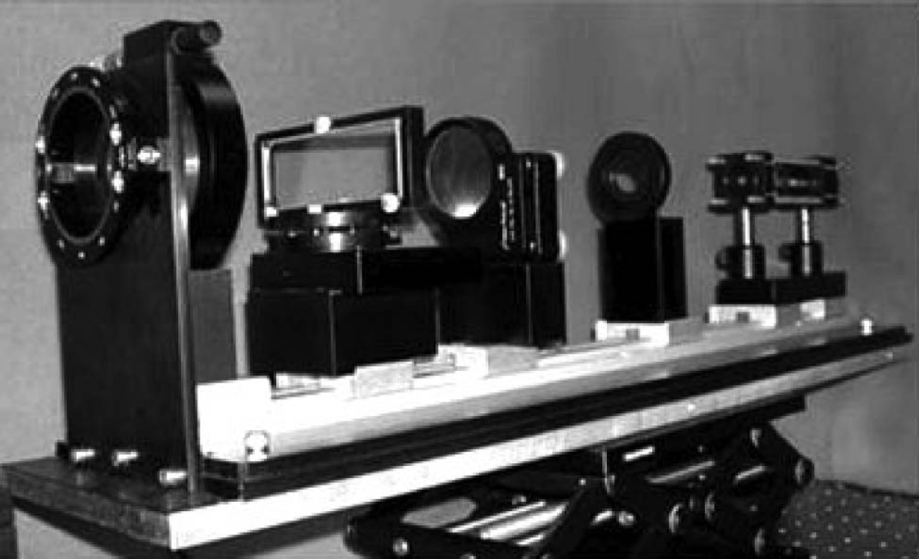
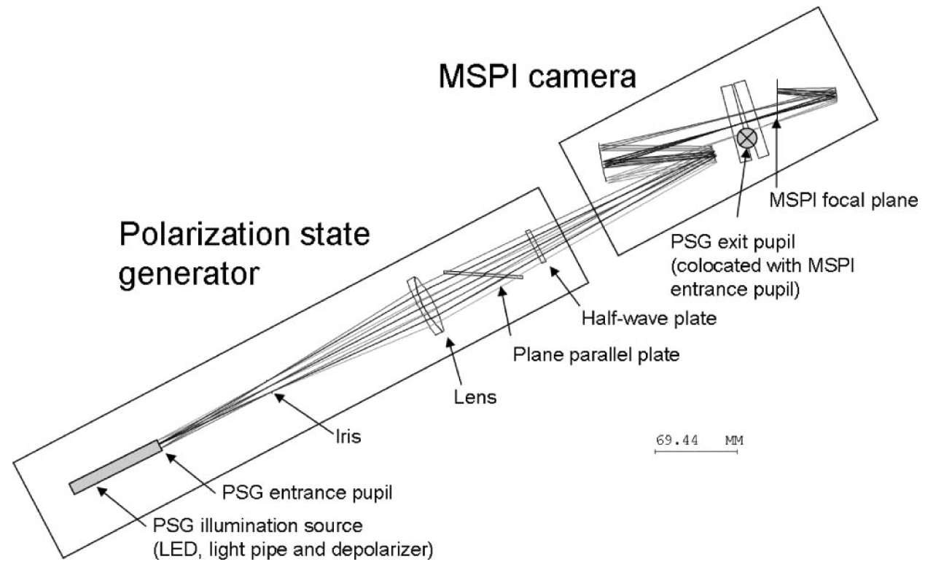
Stimulus philosophy
Depolarize to P<0.0005
Polarize σP<0.0005
Verify σP~0.0005
Mahler & Chipman (2011)
Notes:
Depolarization:
Get low P
Be insensitive to lamp polarization fluctuations
Verification more accurate
Polarization:
0<P<40%
Tilt accuracy -> sP<0.0005
Verification:
- this in the end defines the stimulus’ accuracy

Slide 11
Preliminary design
Lamp P~0.05
Fiber ×0.1???
Integrating sphere × <0.005
Liquid crystal scrambler (MTR) × <0.01
Crossed glassplates in gimbal mount
Slow lenses (P~0.0005 @ 2° refraction -> f~300 mm)
Notes:
Fiber TBD
Very bright light source
Fiber coupling with integrating sphere
MTR: multi-twist retarder -> achromatic half-wave retarder; retarder axis random orientation every 10 micron
Different glass plate materials + coatings for different DoLP ranges / DoLP resolution / lambda ranges
AR coating on 1 side to prevent multiple reflections
2 crossed glass plates to cancel beam shift

Slide 12
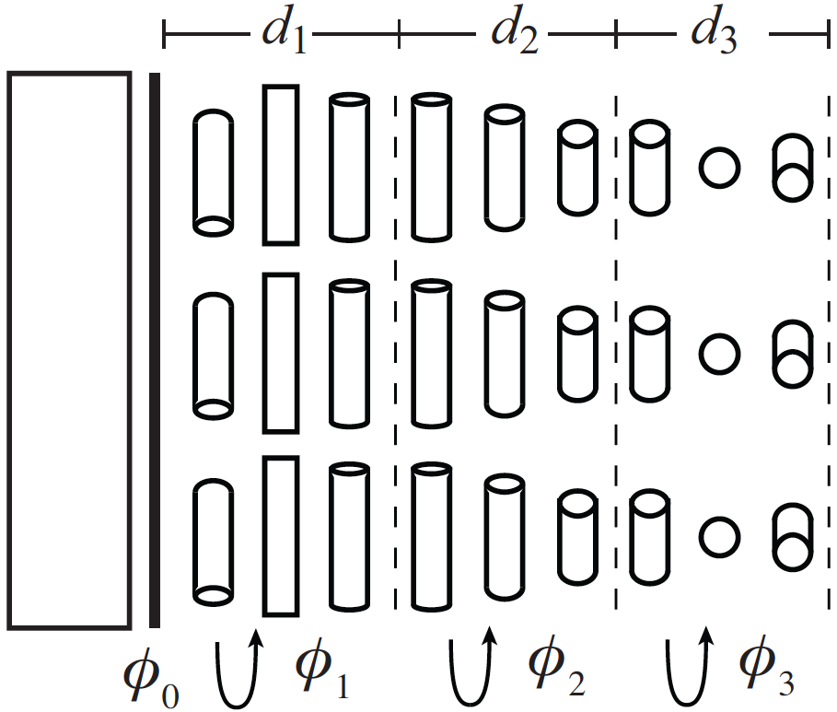
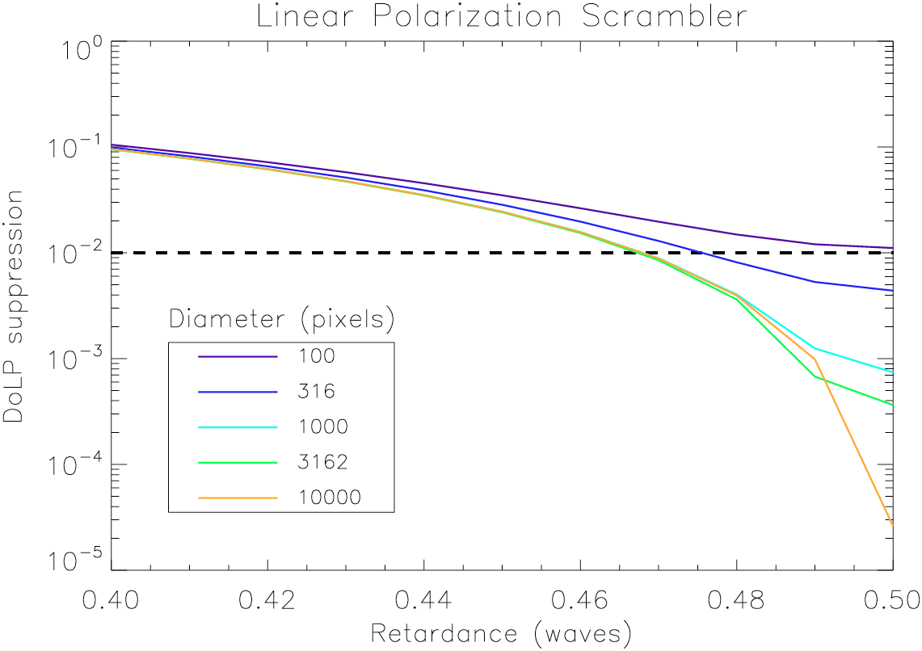
Multi-twist retarder
Self-aligning liquid crystals
Achromatic @ 3 layers
Spatial resolution ~ 10 μm
Komanduri et al. (2013)
Notes:
- Substrate with pattern on 1 side
-

Slide 13
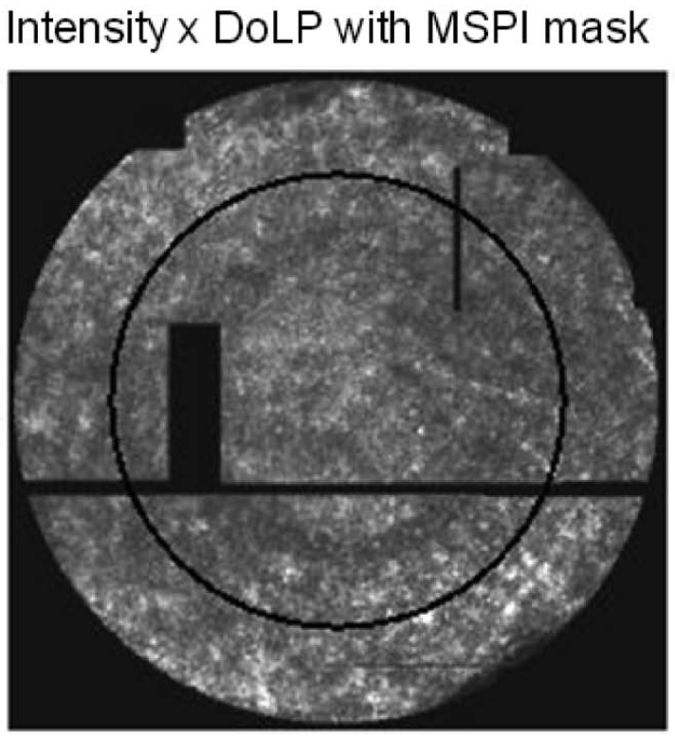
Challenges
Pupil alignment
Oversize
Make uniform
Measure map
σP=0.00005 / mm
Lens polarization
Lens stress birefringence
Straylight / reflections
Verification @ σP=0.0005
Mahler & Chipman (2011)

Slide 14
Stimulus verification
Chicken / egg
Model
All separate components
Total system – sensitivity analysis
Measure
Imaging polarimetry pupil
Different pupil alignments
Confidence: understanding + P~0.0001 measurement

Slide 15
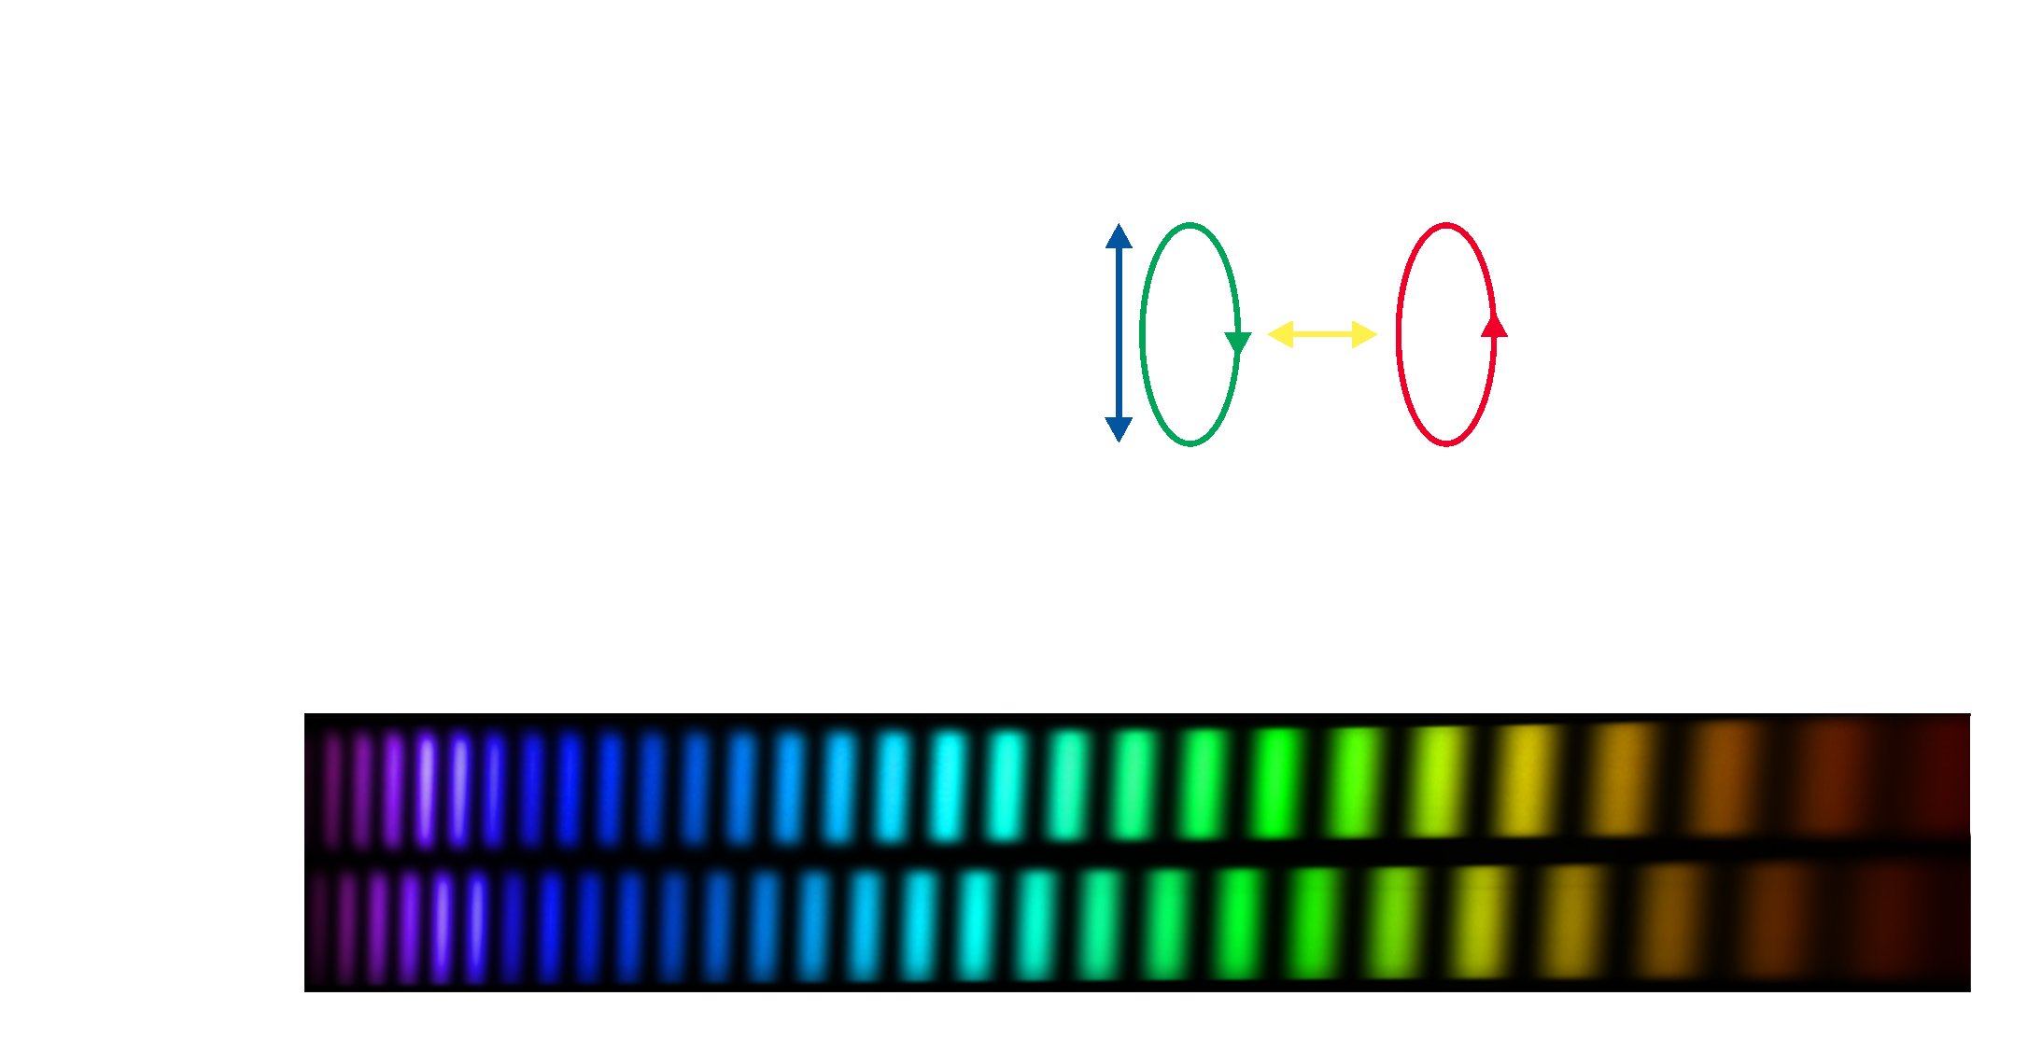
SPEX spectral polarization modulation
Snik et al. (2009)

